Slide 1


UK Automotive Trade Snapshot
October 2024
Matthew Croucher,
Chief Economist, SMMT
Alessandro Marongiu
Senior Trade Policy Manager, SMMT

Slide 2
Total UK automotive trade value
Total automotive trade value has fully recovered
Sector has consistently regained position of £100bn+ trade hub
Landmark £115bn threshold reached in 2023
Both imports and exports above pre-pandemic levels
£47bn auto exports in 2023:
£68bn auto imports in 2023
Expansion phase slowing down (down £1bn in H12024 RY basis)

Slide 3
Automotive exports driving UK manufacturing
The sector is a key contributor to UK export performance
UK automotive industry is the largest exporter of British manufactured goods
Sectoral weight is increasing, with exports’ share reaching 13.9% between July 2023-June 2024
UK automotive exports have consistently covered more than 10% of all UK exports of manufactured goods despite facing major headwinds over the last 5 years
Source: ONS

Slide 4
Total trade in finished vehicles
IM-EX of all types of finished vehicles driving int. automotive trade (£91bn+)
Robust growth in 2023 (+20.1% YoY)
Imports recovery stronger than exports’ (up 35.2% vs 5% in 2019-2023)
Source: UKTradeInfo

Slide 5
Car export by value
A slow recovery
Value of passenger car exports not fully recovered post-Covid, slightly below £30bn
H12024 RY value of PC exports to the EU 6.1% smaller than pre-Covid/pre-Brexit levels
Value of PC exports to ROW underperformed between 2019-2023, but accelerated in 2024
Source: UKTradeInfo

Slide 6
UK vehicle production - exports
Heavy export focus: four in five cars and two in three CVs are exported
Vehicle output recovered to 1m+ units in 2023, up 17%, as supply issues eased
Exports up 18.4%, share up to 77.1%
Car exports +7.6%, share to 78.9%. CVs +25.8%; share 63.9%
Into 2024, volumes have receded due to EV transition
Export share slipped to 76% cars, but up to 66% CVs (rolling yr)
Source: SMMT

Slide 7
Car exports by type and destination
Volume focus on EU, premium and SVM broader splits
Volume OEMs saw 32.3% export growth in 2023, vs 6.8% premium, 3.9% SVMs
85% Volume OEM X to EU
Premiums X 39% to EU, 29% Asia and 25% America
SVMs Asia is largest X destination, 41%, then America and then EU
Source: SMMT

Slide 8
Car imports by value
A robust rebound
Car imports value has rebounded strongly (up 32.3% vs 2019)
Both EU and non-EU imports are above 2019
Imports from ROW grew by 189.8% compared to pre-Covid levels
EU car imports up 9.5% vs 2019
Car imports are flattening in line with industry trend
Source: UKTradeInfo

Slide 9
New car registrations - imported cars
Imports share hits new high
UK new car market remains open to the rest of the world
Imported units 90%+ of new registrations – a new high
Share stable in 2024
Volumes rose 18.6% in 2023 to 1.72m – best since 2m+ level in 2019
Volumes in 2024 up 4.1% in Jan-Sept period
Source: SMMT

Slide 10
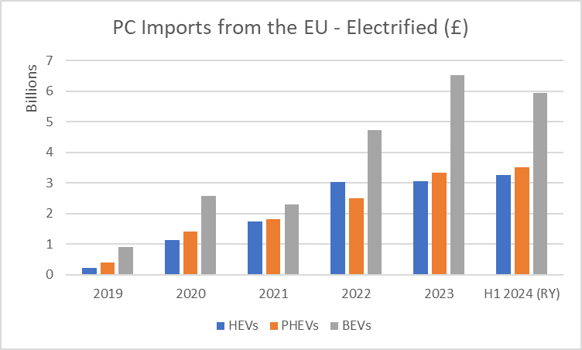
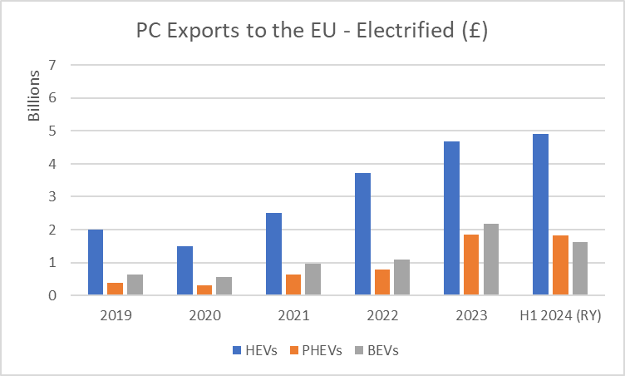
EU-UK Trade: EV vs ICE value
Electrified vehicles driving regional trade growth
Source: UKTradeInfo

Slide 11
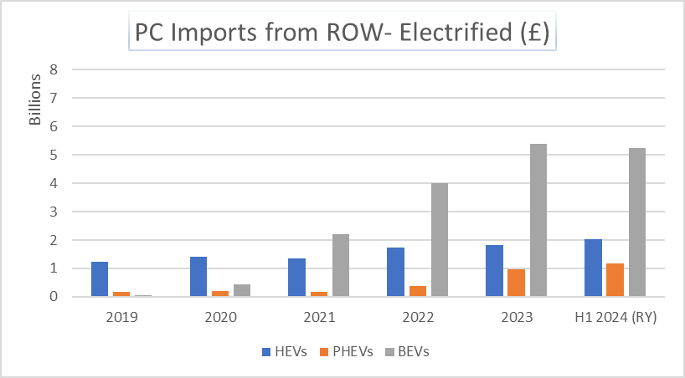
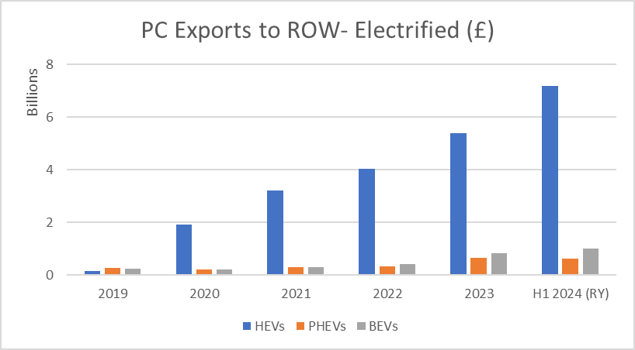
UK-ROW Trade: EV vs ICE value
Electrified vehicles becoming dominant for IM/EX with ROW
Source: UKTradeInfo

Slide 12
Parts and components: Total value
European supply chain remains pivotal
Source: UKTradeInfo

Slide 13
Conclusions
Automotive has fully regained status of £100bn+ trade powerhouse
The sector is the largest exporter of British manufactured goods, and its weight is increasing despite headwinds
Expansion phase is slowing down, with import and export values flattening
The sector remains export-oriented, while domestic market remains open to imports
Post-Covid rebound offers mixed picture, with imports performing better than exports and a growing deficit
The EU is the dominant trading partner for imports and exports, including BEV imports despite fierce competition
The US is regaining central role for UK car exports after years of decline
Preferential market access to top export destinations is diminishing
Trade in electrified vehicles increasingly important, with ICE trade regularly below 2019 level
Driven by hybrids, UK EV exports have consistently outperformed ICE exports
Growth in electrified vehicle imports driven by BEVs
Despite continued interdependency, UK-EU trade has underperformed vs UK-ROW
Growth gap between EU and ROW post TCA has become structural for imports of finished vehicles and
export of parts
The gap is wide on imports of BEVs, with ROW imports outpacing imports from the EU
UK suppliers suffering worst consequences of new trade barriers, with parts exports to the EU below 2019

Slide 14

Recommendations

